Slide 1

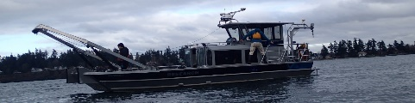

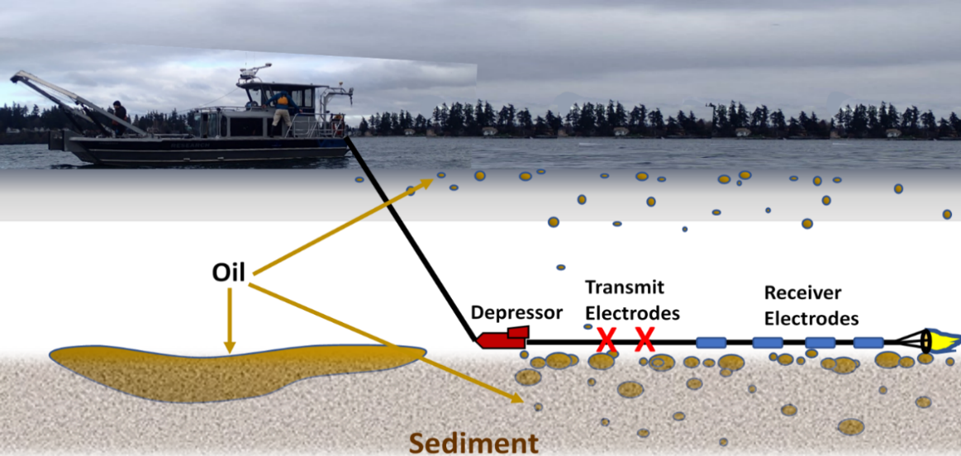
ADAC Year 8 First Quarter Quarterly Review
...Via Conference Call, 23-24 September 2021
ADAC Project Briefing
Marine IP - Detection and Mapping of Oil Under Ice:
A Ruggedized Field Kit
Researcher Kari Walker, IntelliSense Marine LLC
PI Dr. Scott Socolofsky, Texas A&M University

Slide 2
ADAC Project: Marine Induced Polarization Methods for the Detection and Mapping of Oil in an Arctic Marine Oil Spill – Ruggedized Field Kit Production and Testing
ADAC Program Year 8 First Quarter Quarterly Review 23-24 September 2021
• Project Principal Investigator: Dr. Scott Socolofsky, Texas A&M University
• Supporting Team:
  Ms. Kari Walker and Mr. Kevin Hand, IntelliSense Marine
  Mr. Art Wright, Mr. Jay Radler and Mr. Todd Stedman, Induced Polarization Associates
  Mr. Nathan Lamie, Lead Engineer/Facility Operator, Cold Regions Research and Engineering Laboratory, U.S. Army Corps of Engineers
• Project Champion: LCDR Clifton Graham, CG-MER

Slide 3
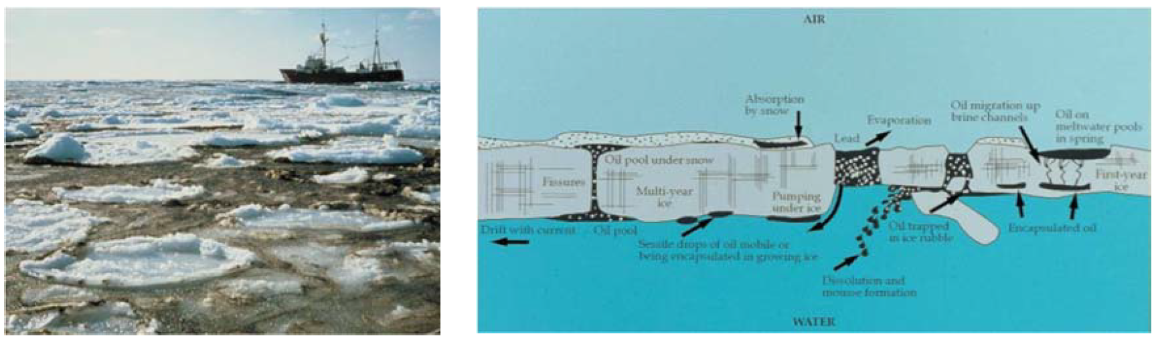
Marine IP: Project Description and Baseline
ADAC Program Year 8 First Quarter Quarterly Review 23-24 September 2021
Project Description: Federal on-scene spill responders need remote sensing tools to detect and map oil in the open-Arctic ocean, broken ice fields, as well as oil under and within ice.
This research effort will build and test hardware and software for an Arctic-Ready Marine Induced Polarization (Marine IP) System, which locates and assesses polarizable mineral and particle distributions - such as hydrocarbons - in water, ice and in sediment.
Baseline: Marine IP has shown strong promise to serve as a tool for the detection and mapping of oil under ice and in seafloor sediment. A robust, Arctic-Ready Marine IP system needs to be developed to mitigate the harsh conditions of the Arctic.

Slide 4
Marine IP: Method
ADAC Program Year 8 First Quarter Quarterly Review 23-24 September 2021
Oil on and within seafloor sediment:
A cable is towed behind a vessel
Transmit electrodes emit a controlled electrical current
Receiver electrodes measure changes in the return signal caused by substances encountered
Oil
Transmit Electrodes
Receiver Electrodes
Depressor

Slide 5
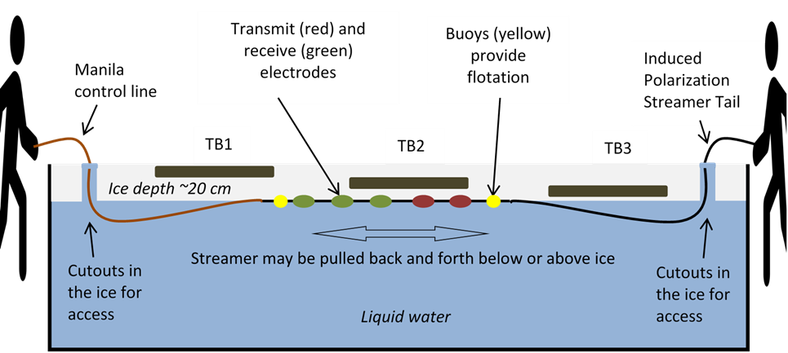
Marine IP: Method
ADAC Program Year 8 First Quarter Quarterly Review 23-24 September 2021
Oil-Under-Ice testing: CRREL Testing Facility
A cable streamed under tank ice
Transmit electrodes emit a controlled electrical current
Receiver electrodes measure changes in the signal due to substances encountered
Transmit (red) and receive (green) electrodes
Induced Polarization Streamer Tail
Induced Polarization Streamer Tail
Buoys (yellow) provide flotation
Control line
Test Area
Test Area
Test Area
Water at 0.25 Salinity

Slide 6
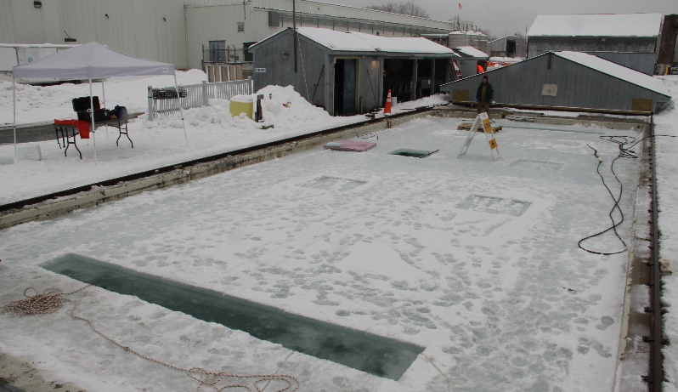
Marine IP: Method
ADAC Program Year 8 First Quarter Quarterly Review 23-24 September 2021
CRREL Testing Facility
Oil-Under-Ice testing: CRREL Testing Facility:
Tests will be conducted using shared oil under ice conditions:
  Existing oil placement will be well documented
  Additional oil will be added under and encapsulated within the ice
Transmit (red) and receive (green) electrodes
Induced Polarization Streamer Tail
Buoys (yellow) provide flotation
Control line
Test Area
Test Area
Test Area
Water at 0.25 Salinity

Slide 7
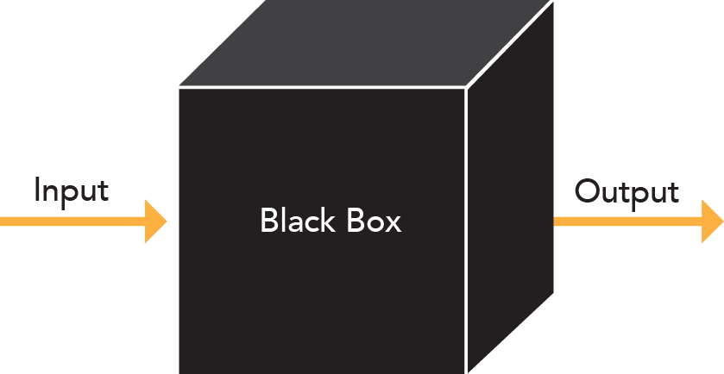
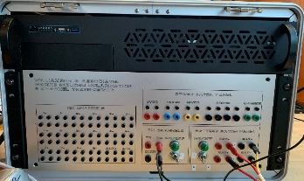
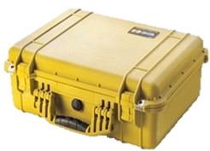
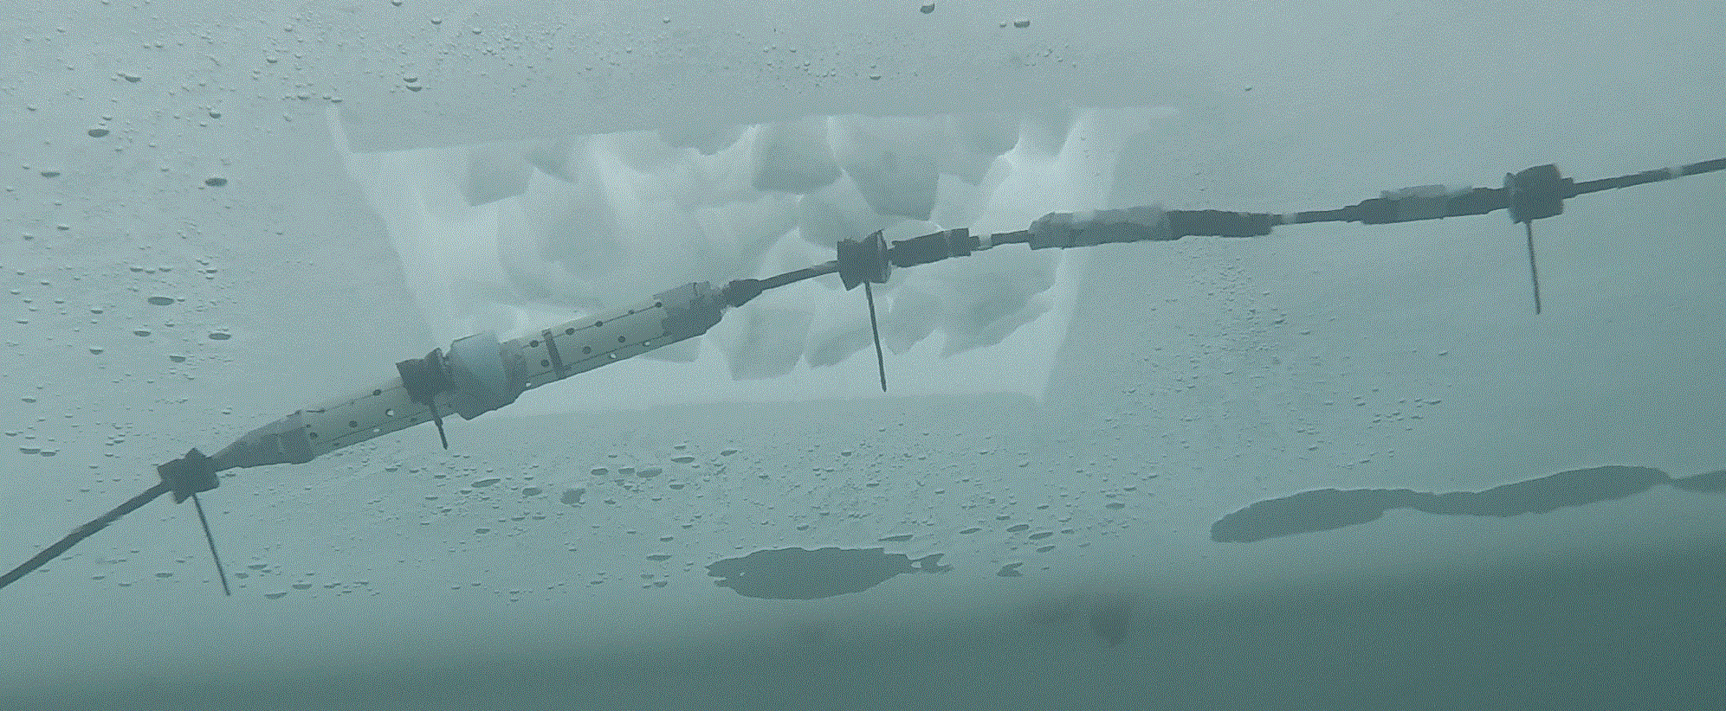
Marine IP: Progress on Research Objectives
ADAC Program Year 8 First Quarter Quarterly Review 23-24 September 2021
Project Objectives:
Continue to validate Marine IP as a viable means to detect oil within ice and broken ice.
Develop and build the hardware, firmware and software for an Arctic-Ready Marine IP System that can withstand the harsh environment of the Arctic: Q1-Q2
Test the Arctic-Ready Marine IP System in an offshore, towed scenario: Feb 2022
Test the Arctic-Ready Marine IP System in a simulated Arctic environment scenario (CRREL): Feb 2022
Further identify possible Marine IP deployment mechanisms for characterization, with emphasis on AUVs: Q4
Old Enclosure
New Enclosure

Slide 8
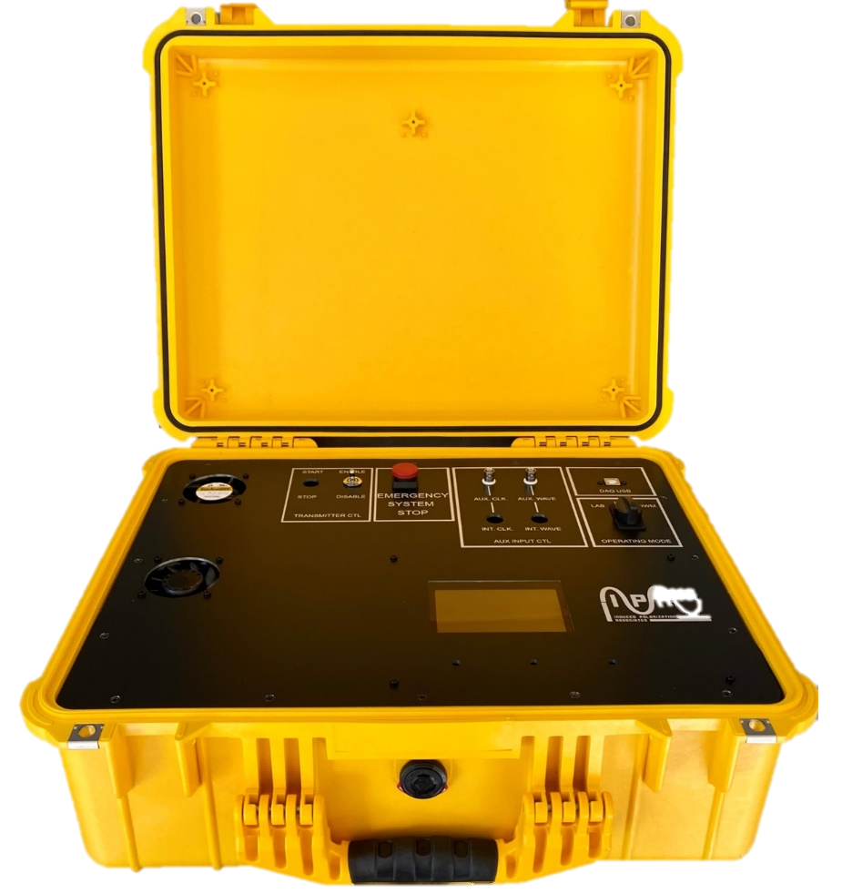
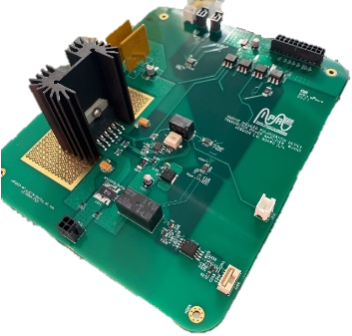
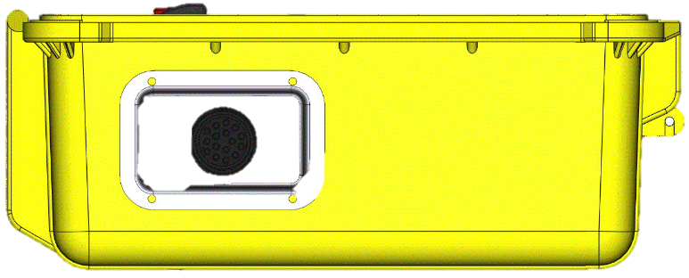
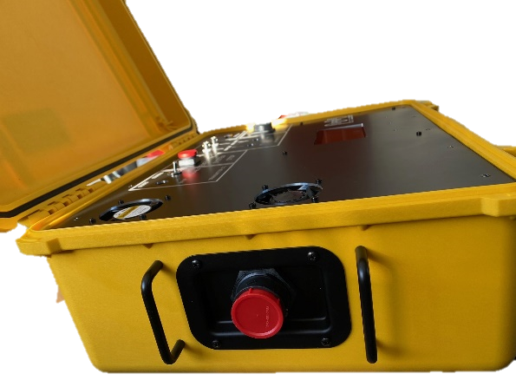
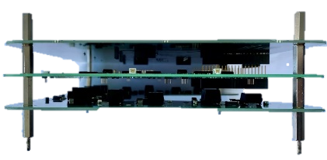
Marine IP: Progress on Milestones
ADAC Program Year 8 First Quarter Quarterly Review 23-24 September 2021
Project Milestones – Hardware Designed and Built
  Fabricate prototype. Complete
Custom build of electronic boards complete.
Design.
Build.

Slide 9
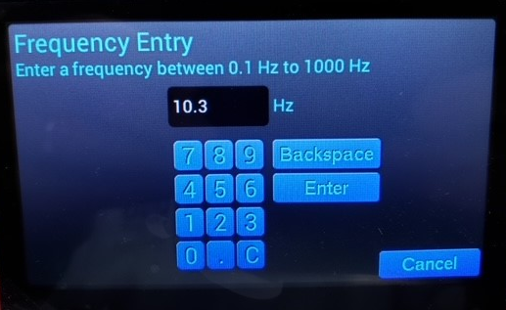
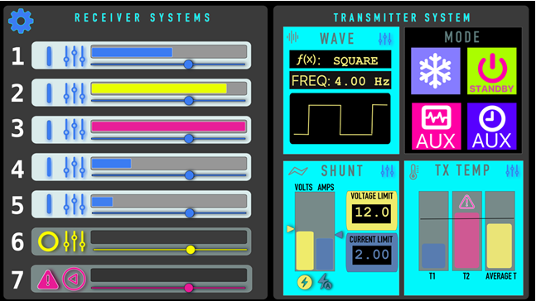
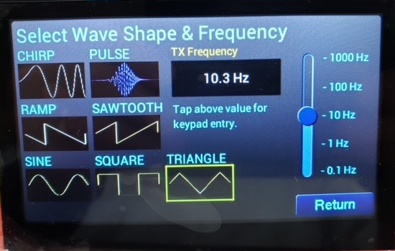
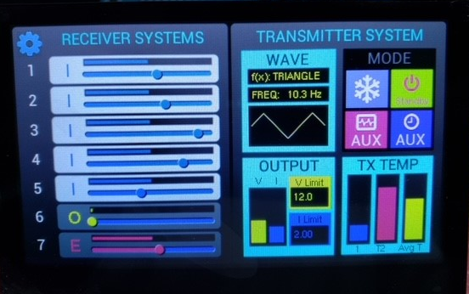
Marine IP: Progress on Milestones
ADAC Program Year 8 First Quarter Quarterly Review 23-24 September 2021
Design and write prototype firmware. 90% Complete
  Working to complete Transmitter Microcontroller, Touch UI Display
Display Interface: Design
Display Interface: Build

Slide 10
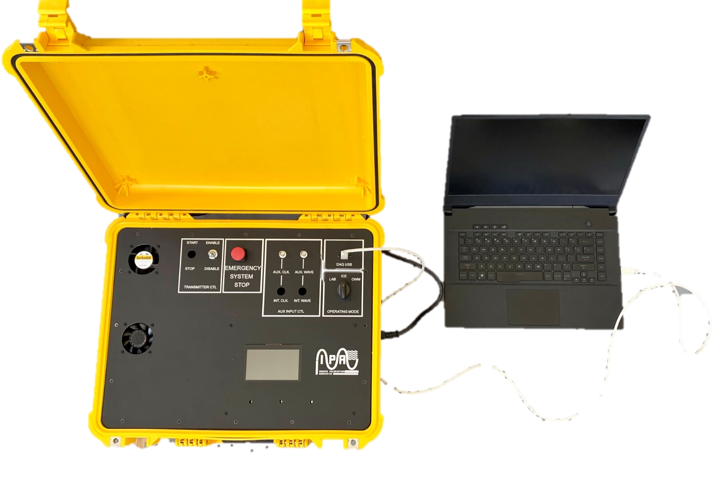
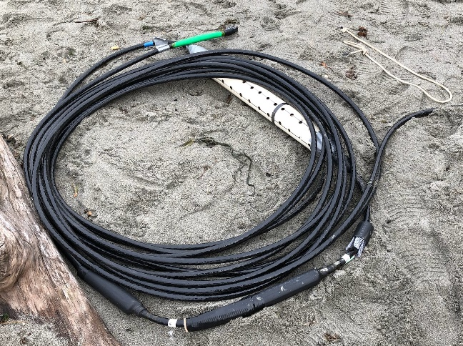
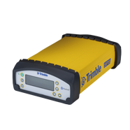
Marine IP: Progress on Milestones
ADAC Program Year 8 First Quarter Quarterly Review 23-24 September 2021
New Marine IP Enclosure
  Fabricate prototype. Complete
Marine IP Cable
Laptop
GPS

Slide 11
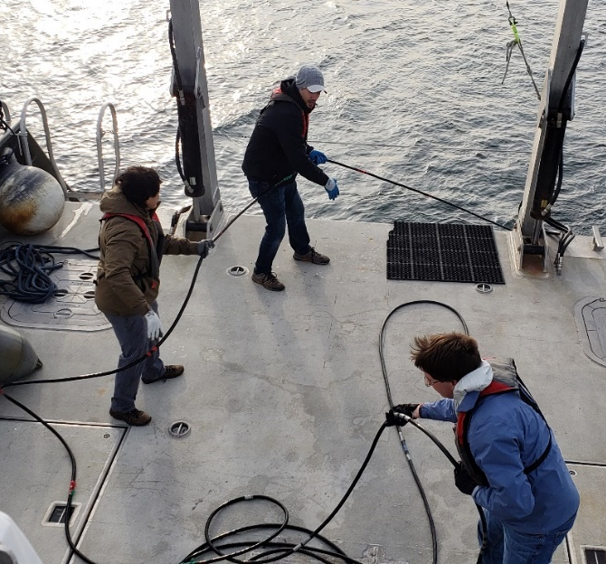
Marine IP: Planned Field Work
ADAC Program Year 8 First Quarter Quarterly Review 23-24 September 2021
Planned for February 2022
Oil-Under-Ice testing: CRREL Testing Facility
Tests using shared oil under ice conditions:
Open Water Testing: Puget Sound
Tests on a vessel in Puget Sound, WA:
CRREL Testing Facility

Slide 12
Marine IP: Progress on Milestones
ADAC Program Year 8 First Quarter Quarterly Review 23-24 September 2021
Firmware developed and undergoing small-scale laboratory tests and bug fixes. October 15th
Startup and initial performance and function tests. October 22nd Hardware Complete. Pending firmware.
Submit Field Test Plans for HQ USCG Project Champion review and approval. In Progress
Complete performance and functional tests in laboratory. In Progress. Pending firmware.
Submit engineering report reviewing design, fabrication methods, construction, and initial performance reviews of hardware system. Complete. Will be update upon completion of firmware and testing.
Complete mockups of user interfaces and software control systems. In Progress Software will be revised for after completion of firmware and testing.
Hardware: Beach testing of device and its integrations with the Marine IP cables. November 2021
Complete implementation of Arctic-Ready Marine IP System – Hardware, Software. January 2022
Complete Field Trials of Arctic-Ready Marine IP System. February 2022
Complete data analysis and reporting. March 2022

Slide 13
Marine IP: Progress on Outcomes/Outputs
ADAC Program Year 8 First Quarter Quarterly Review 23-24 September 2021
  Provide test plan for Arctic-Ready Marine IP System. December 2021 - January 2022
Arctic-Ready Marine IP System – Hardware: Provide a Marine IP measurement field kit designed for use in arctic conditions. December 2021
Arctic-Ready Marine IP System – Software: Provide a new software interface for data collection using the Marine IP measurement field kit. December 2021
Technical Report: Provide DHS with a report with all the results of this research that becomes publicly available. March 2022.
Engineering Design Report: Provide advanced information for the design parameters for applications of Marine IP with an autonomous underwater vehicle (AUV). March 2022
Peer-Reviewed Publications: Research team will produce draft peer-reviewed scientific publications from this project. 2022
Publicly Available Data: Researchers (in coordination with ADAC) will ensure all releasable data produced during this project is publicly available within 6 months of project conclusion. 2022

Slide 14
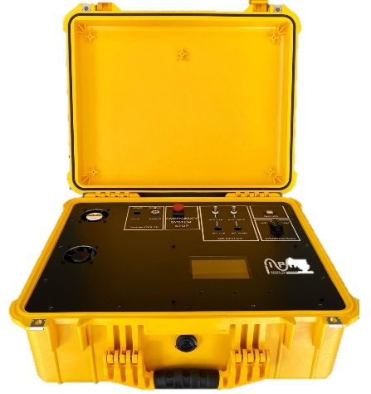
Marine IP: Progress on Remaining Year 6 Objectives
ADAC Program Year 8 First Quarter Quarterly Review 23-24 September 2021
Old System
Remaining Project Objectives:
Investigate the potential of Marine IP to detect oil in partial ice formations as well as under pack ice.
Investigate and determine Marine IP’s effectiveness to accurately detect the extent of contaminated areas.
Remaining Project Milestones:
Determine the spectral signature of selected target contaminants utilizing the new Marine IP system.
Complete data analysis and reporting.
New System

Slide 15
Thank you!
ADAC Program Year 8 First Quarter Quarterly Review 23-24 September 2021
Feedback…
What are we missing?
What can we improve?
Who should we connect with to improve odds of research success?

